Slide 1
Section 9.1
Applications Involving Right Triangles
Copyright © 2012 Pearson Education, Inc. Publishing as Prentice Hall.

Slide 2

Copyright © 2012 Pearson Education, Inc. Publishing as Prentice Hall.

Slide 3
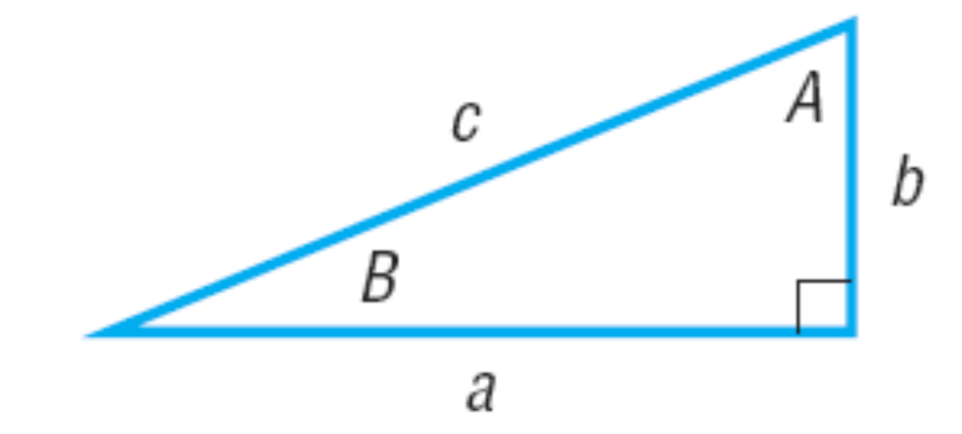

Copyright © 2012 Pearson Education, Inc. Publishing as Prentice Hall.

Slide 4



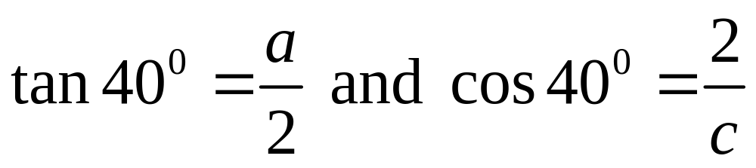
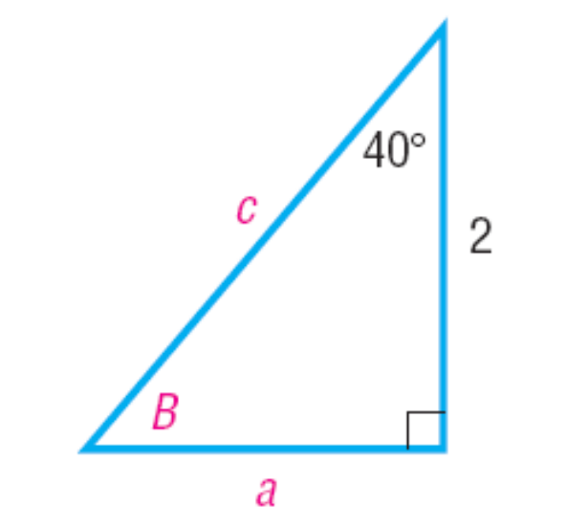
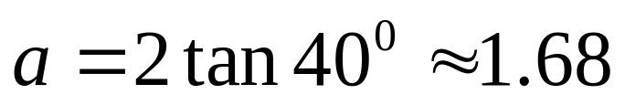

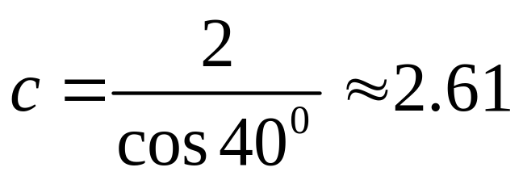

50°
Copyright © 2012 Pearson Education, Inc. Publishing as Prentice Hall.

Slide 5
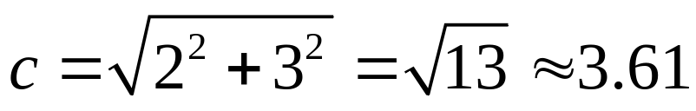
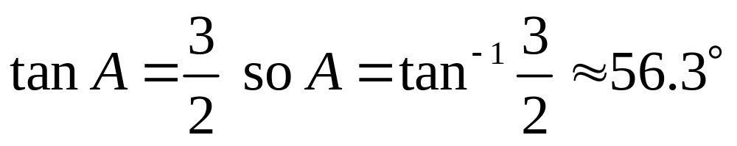
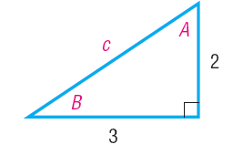


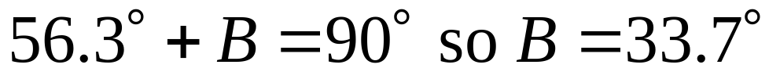

Copyright © 2012 Pearson Education, Inc. Publishing as Prentice Hall.

Slide 6

Copyright © 2012 Pearson Education, Inc. Publishing as Prentice Hall.

Slide 7
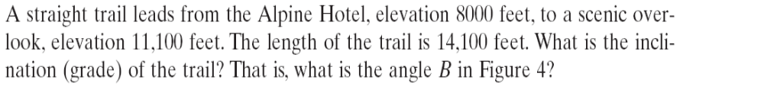
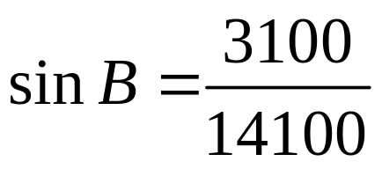
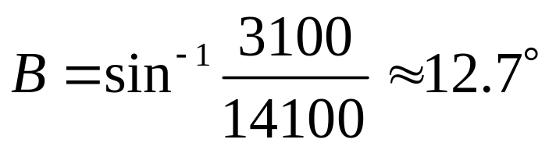
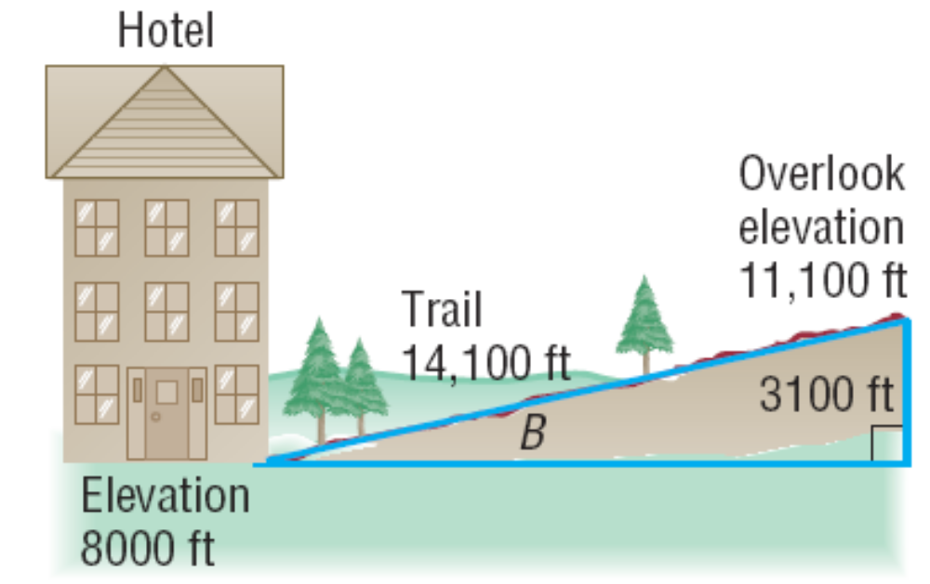
Copyright © 2012 Pearson Education, Inc. Publishing as Prentice Hall.

Slide 8
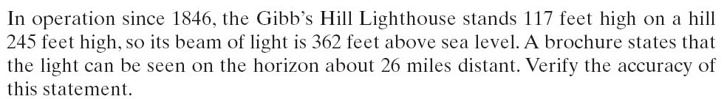
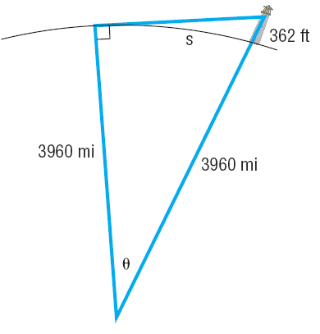
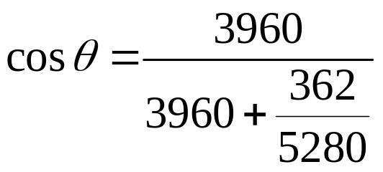
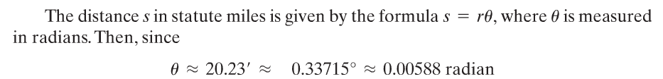

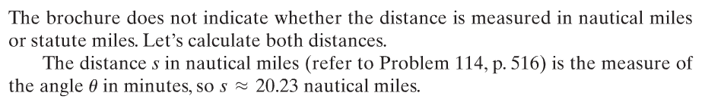
In either case it looks like the brochure overstated the distance.
Copyright © 2012 Pearson Education, Inc. Publishing as Prentice Hall.

Slide 9

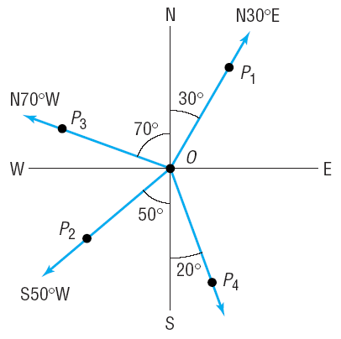
Copyright © 2012 Pearson Education, Inc. Publishing as Prentice Hall.

Slide 10
Copyright © 2012 Pearson Education, Inc. Publishing as Prentice Hall.

Slide 11
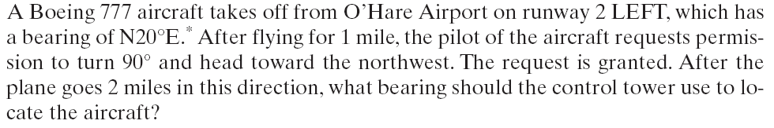

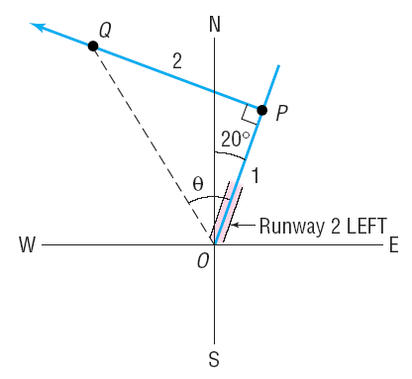
Copyright © 2012 Pearson Education, Inc. Publishing as Prentice Hall.

